Slide 1
Art Exhibition
Theme: Experience

Slide 2
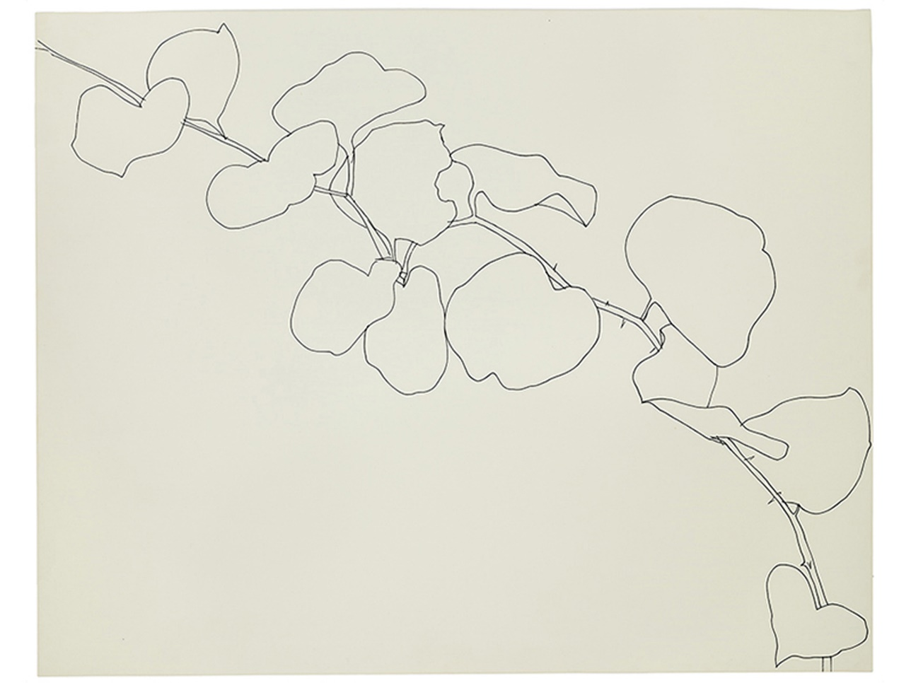

Ellsworth Kelly
Brier
1961
Black ink on wove paper,
Wadsworth Atheneum Museum

Slide 3
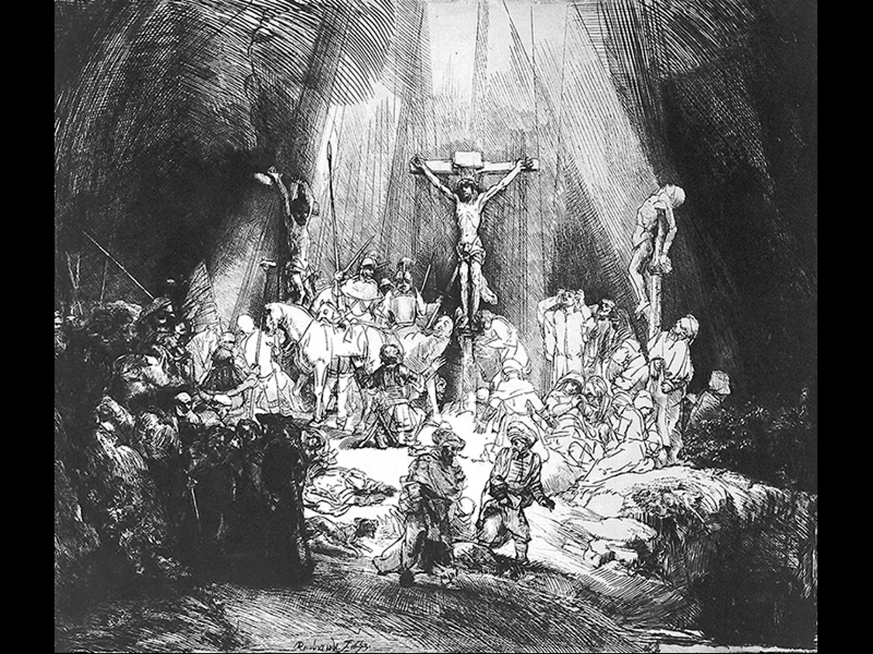

Rembrandt Van Rijn, The Three Crosses, 1653
Etching.
British Museum

Slide 4
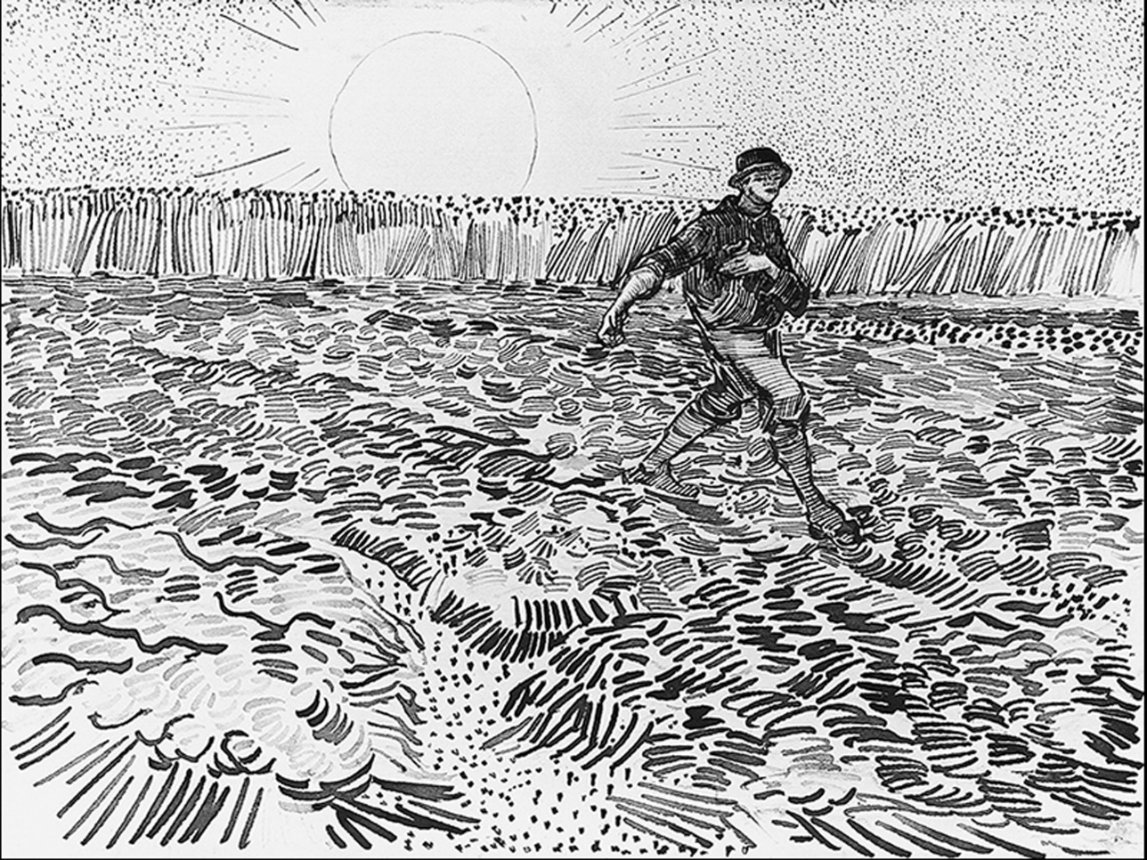

Vincent Van Gogh,
The Sower,
1888
Drawing. Pencil, reed pen, and brown and black ink on wove paper
Van Gogh Museum, Amsterdam

Slide 5
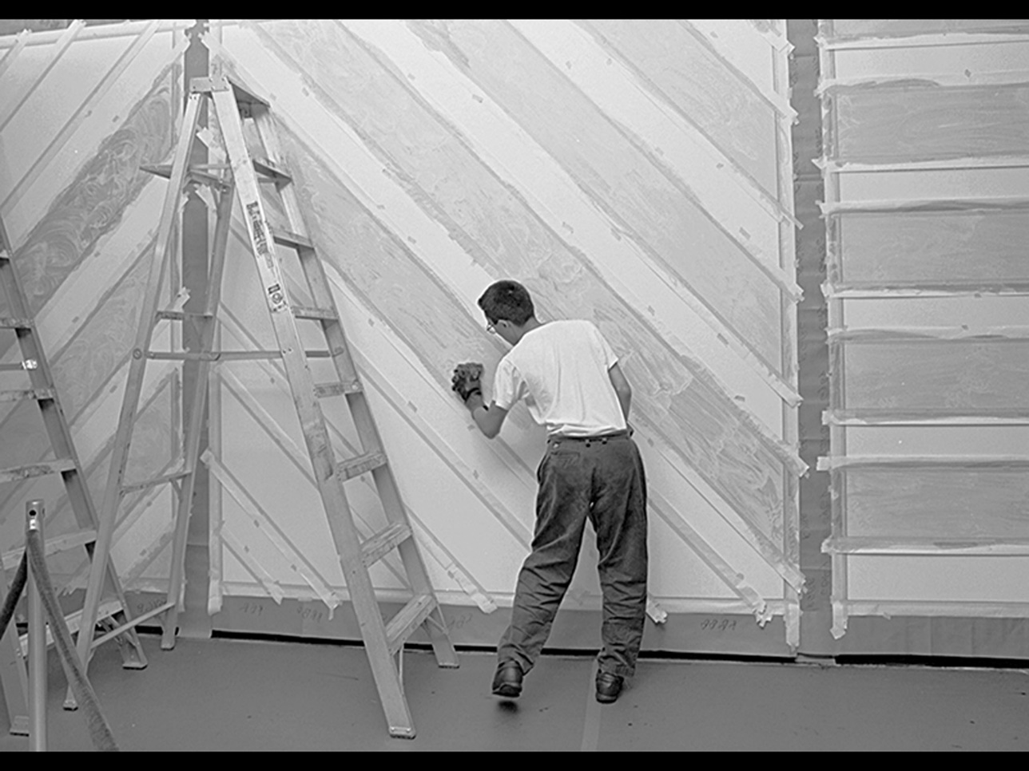
Installation of Wall Drawing
No. 681 C.August 25, 1993. National Gallery of Art, Washington

Slide 6

Robert Mapplethorpe,
Lisa Lyon,
1982
© Robert Mapplethorpe Foundation

